Slide 1
CSCE 1035 Computer Programming I Chapter 11 Modules
University of North Texas

Slide 2

11.1 Modules

Slide 3

Modules
A module allows you to logically organize your Python code
Grouping related code into a modules makes the code easier to understand and use
A module should end with the .py extension
More simply, a module is a file consisting of Python code
A module can define functions, classes, and variables, and even contain runnable code
Each module has its own private symbol table used as the global symbol table by all functions in the module

Slide 4
Modules
A module’s definitions can be imported into other modules using the import statement
import module1[, module2[,… moduleN]
When the Python interpreter encounters an import statement, it imports the module if it is present in the search path
This makes the definitions within that module available for use by the importing program
Functions defined in the module can now be accessed with the dot operator
import statements are usually placed at the top of the file
A module being required by another program is called a dependency

Slide 5
11.2 Finding Modules

Slide 6
Locating Modules
Importing a module begins a search to find the corresponding file on the computer’s file system
The interpreter first checks for a matching built-in module
Examples of built-in modules include sys, time, and math
If no built-in module is found, then the interpreter searches the list of directories contained by sys.path
Directory of the executing script
List of directories given by PYTHONPATH environment variable
Directory where Python is installed
>>> import sys
>>> print(sys.path)
['', '/usr/lib/python36.zip', '/usr/lib/python3.6', '/usr/lib/python3.6/lib-dynload', '/usr/local/lib/python3.6/dist-packages', '/usr/lib/python3/dist-packages']
May not be initially set

Slide 7
Locating Modules
For simple programs, a module is most likely placed in the same directory
For larger projects that contain hundreds of modules or use third-party modules located in different directories, set the PYTHONPATH environment variable
$ PYTHONPATH="${PYTHONPATH}:${HOME}/bin/"
$ export PYTHONPATH
$ echo $PYTHONPATH
:/home/mat0299/bin/
$ python3
Python 3.6.9 (default, Oct 8 2020, 12:12:24)
[GCC 8.4.0] on linux
Type "help", "copyright", "credits" or "license" for more information.
>>> import sys
>>> print(sys.path)
['', '/home/mat0299', '/home/mat0299/bin', '/usr/lib/python36.zip', '/usr/lib/python3.6', '/usr/lib/python3.6/lib-dynload', '/usr/local/lib/python3.6/dist-packages', '/usr/lib/python3/dist-packages']

Slide 8
11.3 Importing Specific Names From a Module

Slide 9
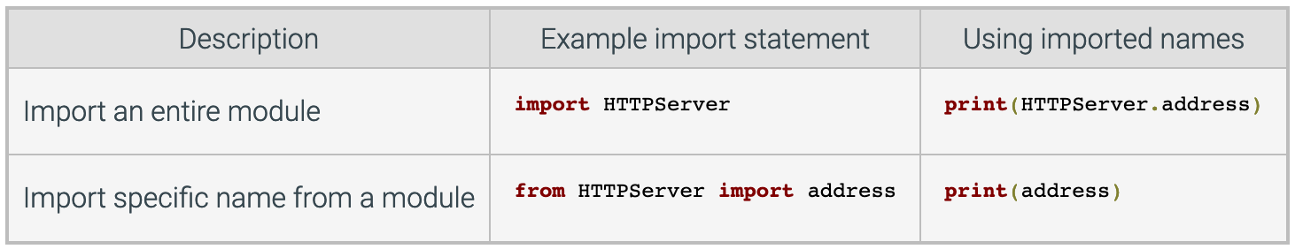
Importing Names from a Module
You can import names from a module into the importing module’s symbol table using from … import …
from module_name import name1, name2, …
Example
>>> from math import sqrt, pi
>>> sqrt(9)
3.0
>>> print(pi)
3.141592653589793
You can import all names from a module into current namespace using *
Using from, dot operator may be excluded

Slide 10
11.4 Executing Modules as Scripts

Slide 11
Executing Modules as Scripts
Python scripts with the .py extension may be executed in the command line using
python3 example.py [arguments]
An import statement executes the code contained within the imported module
Commonly, a programmer wants to treat a Python file as both a script executed by the interpreter as well as an importable module
Imported modules and executed modules can be distinguished by accessing the global variable __name__
Value of __name__ is __main__ only when modules executed
if __name__ == "__main__":
# file can be executed as a script
Otherwise __name__ is the name of the module

Slide 12
11.5 Reloading Modules

Slide 13
Loading Modules
A module is loaded only once per interpreter session, regardless of the number of times it is imported
This is to prevent the module execution from happening repeatedly if multiple imports occur
A dictionary of loaded modules is stored in sys.modules
If the module has not yet been loaded, then a new module object is created
A module object is simply a namespace that contains definitions from the module
If the module has already been loaded, then the existing module object is used

Slide 14
Reloading Modules
If the source code of an imported module needs to be changed, the reload() function can be used to reload and re-execute the changed module without stopping the whole program
The reload() function imports a previously imported module again
The module_name is the name of the module you want to reload
import module # Initial import
...use module.attributes...
... # Now, go change the module file
...
from imp import reload # Get reload itself
reload(module) # Get updated exports
...use module.attributes...

Slide 15
11.6 Packages

Slide 16
Packages
Instead of importing a single module at a time, an entire directory of modules can be imported all at once
Python allows you to organize your modules into subfolders called packages where the name of the package is the name of the folder
A package is directory organized as a collections of modules
Modules are stored in directories, with each directory containing an __init__.py file that tells the interpreter that it is a package directory
The __init__.py file is often empty, but may contain code to initialize the package when imported
Each subdirectory of a root package directory is considered a subpackage, but __init__.py must be present
Python searches through sys.path directories for the package subdirectory

Slide 17
Packages
>>> from mathdir.average import avg
>>> avg([1, 2, 3])
2.0
>>> from mathdir import average, median
>>> median.med([1, 2, 3])
2
…
>>> import mathdir
>>> mathdir.avg([1,2,3])
2.0
__init__.py
…csce1035/fa20
mathdir
average.py
median.py
__init__.py
from .average import avg
from .median import med

Slide 18
11.7 Standard Library

Slide 19
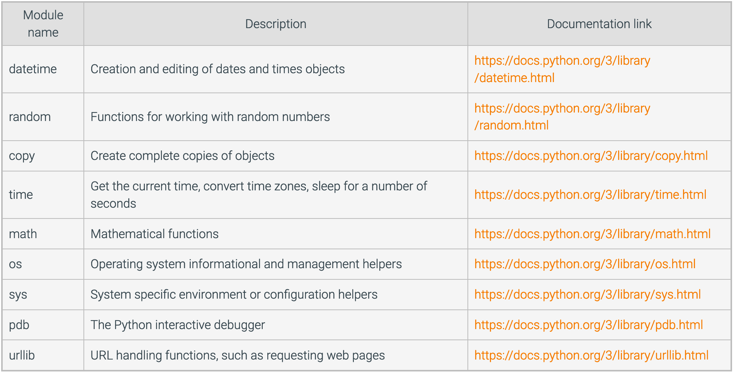
Common Standard Library Modules

